Slide 1
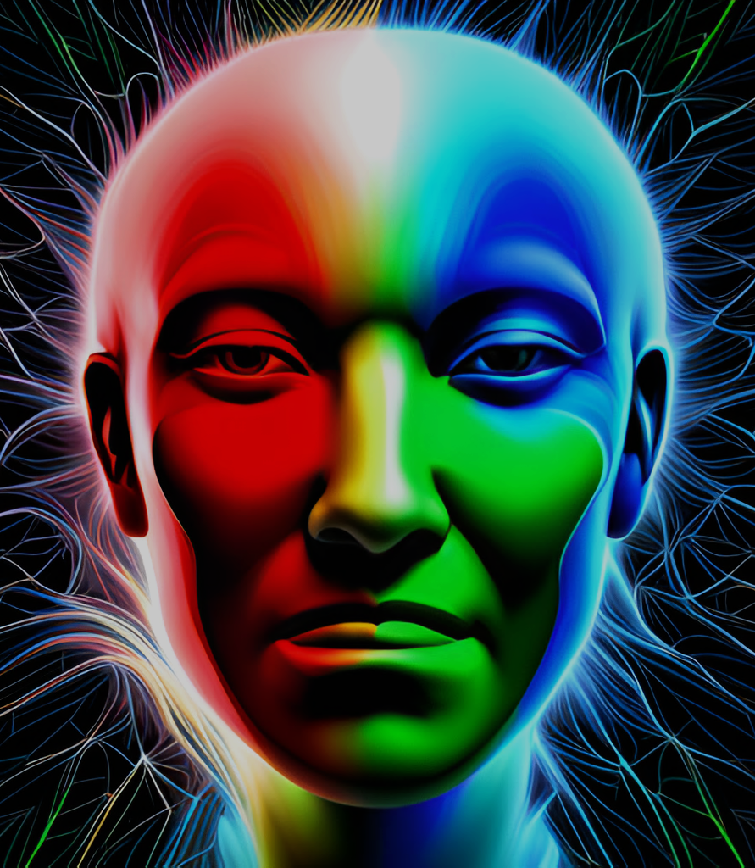

AI-3 C5
An Approach To Uncover The Roots Of Complex Emotions
Team: EmoSense
Ashish Kumar Karthik Rathod Ravindra Manne Swarnava Bhattacharjee

Slide 2
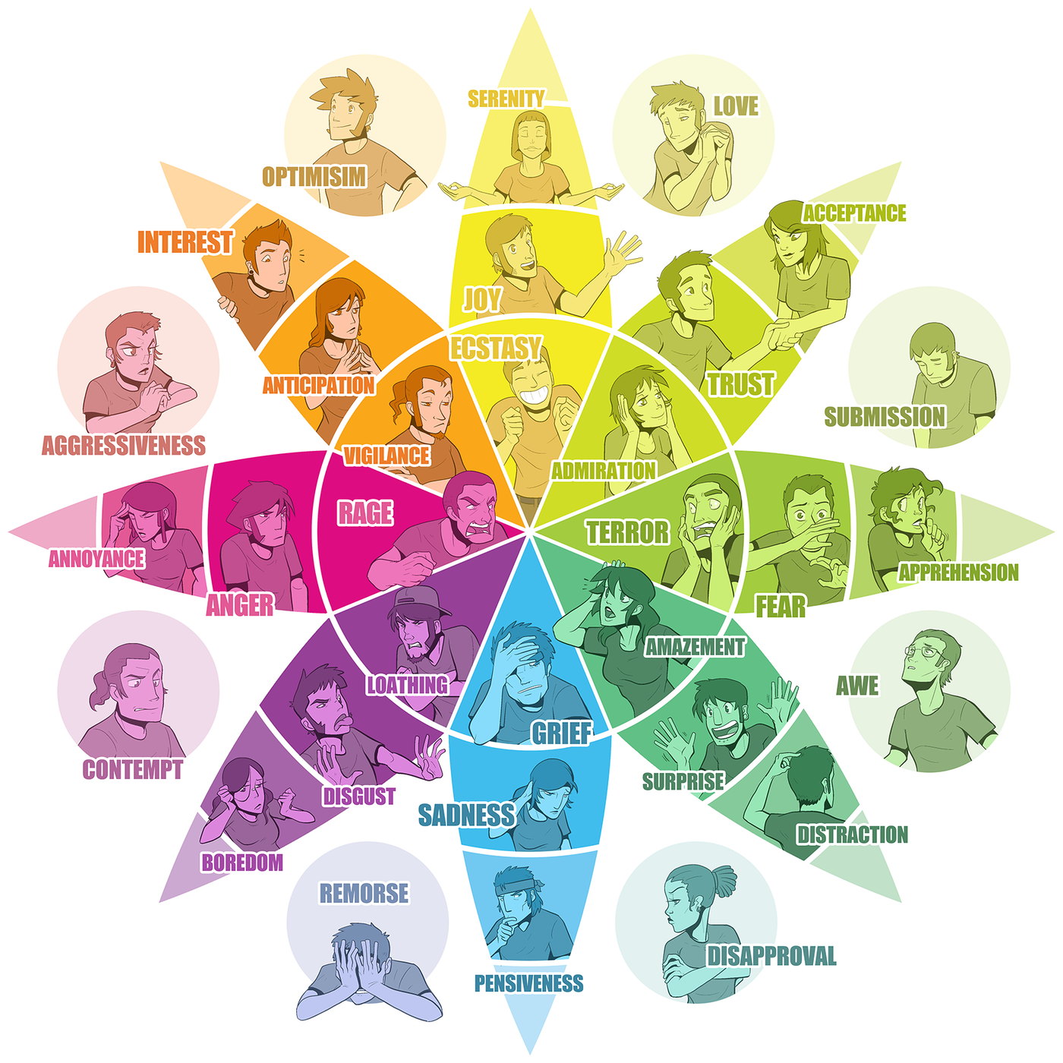
Outline
Challenges in Text Emotion Prediction
Approach
Methodology
Results
Conclusion
Future scope

Slide 3
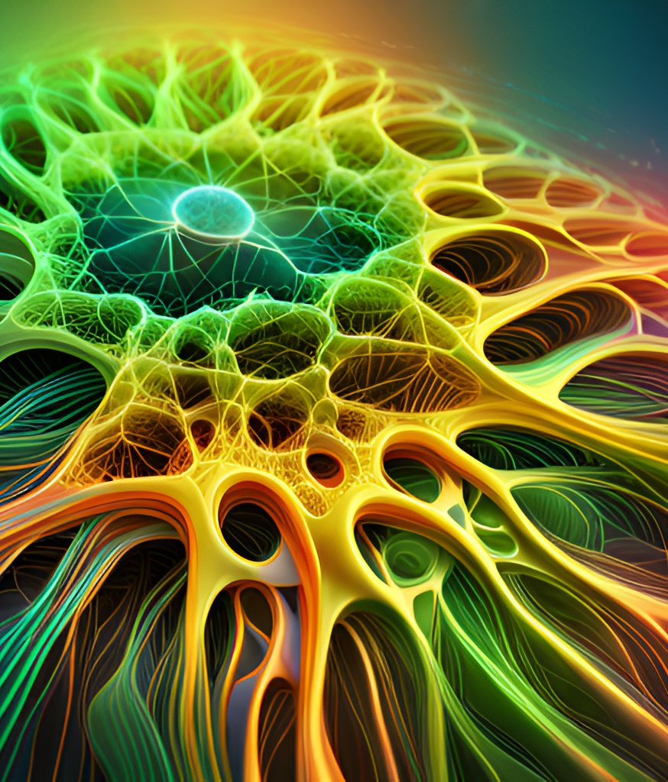
Challenges in Text Emotion Prediction
Human emotions come in wide varieties and intensities. It becomes hard to characterize them just by relating the context to a emotion, thus failing to grasp the writer's core idea. This issue become more prominent when a written text is the only way to comprehend the author's ideas or when words are the sole means of expressing one's emotions. A way must be devised to understand the complex emotions.

Slide 4

Approach
An emotion is a combination of three dimensions which are independent of each other.
Valence(V): The subjective positive or negative evaluation of an experience or stimulus.
Arousal(A): The level of physiological and psychological activation or energy associated with an experience or stimulus.
Dominance(D): The perceived sense of control or power in relation to an experience or stimulus.

Slide 5
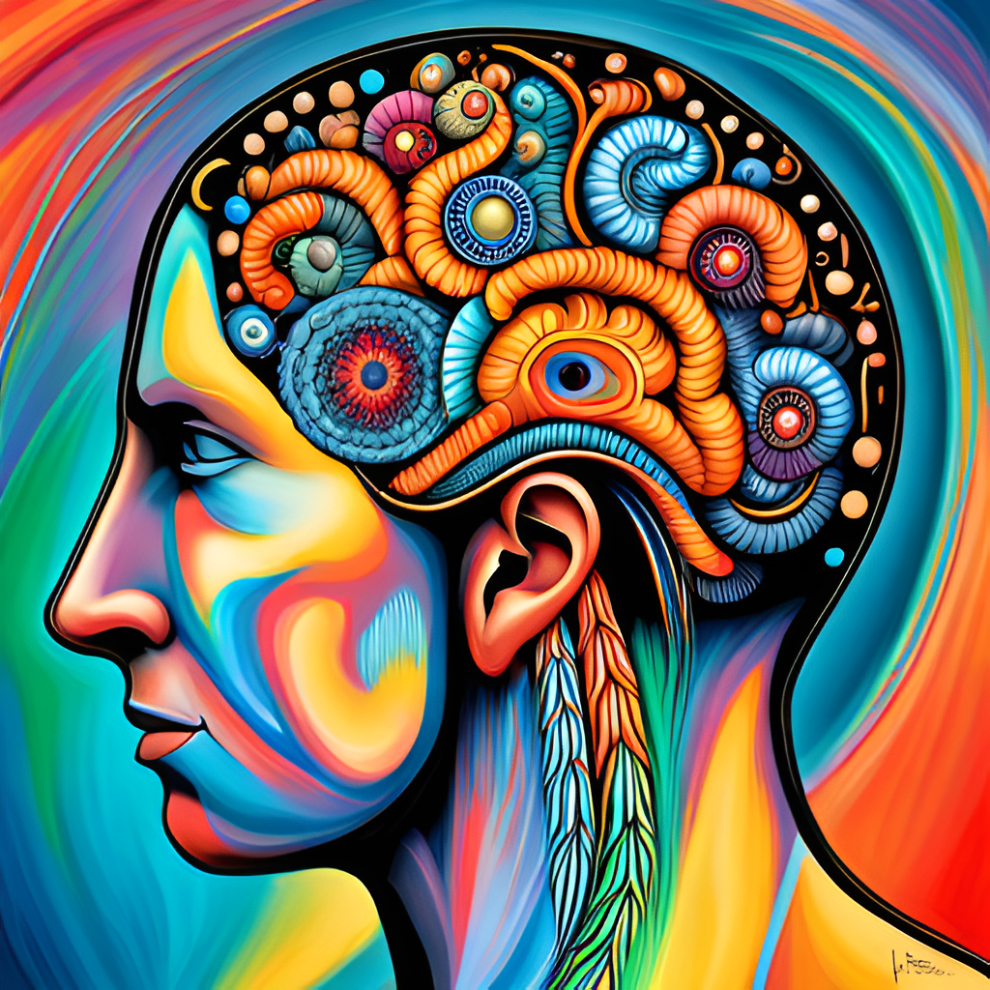
Approach
We will leverage the multi-dimensionality nature of human emotions to create a precise predicting system
This approach will help use over come the restrictive nature of classic classification method which are limited to small set of emotions

Slide 6
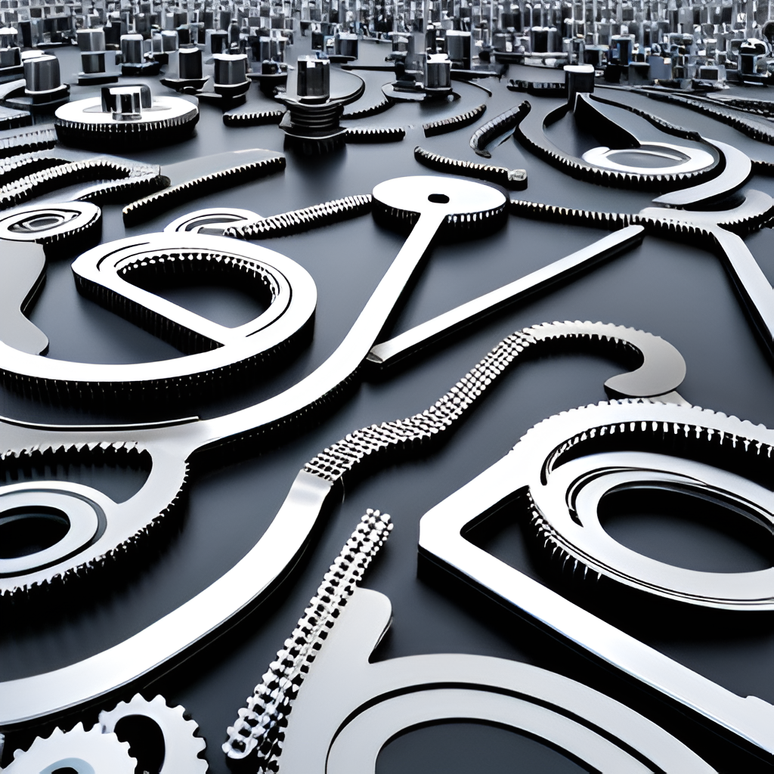
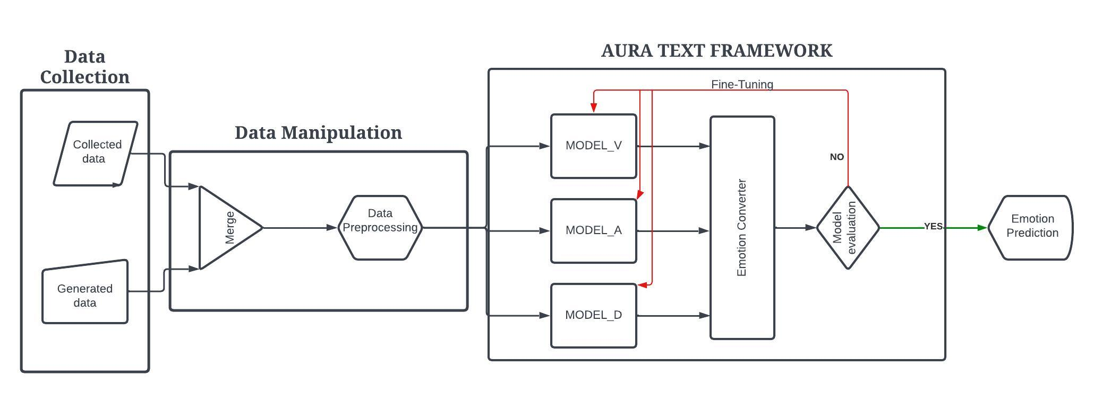
Methodology
The flow of data through the model

Slide 7

Data Collection
The main source of data was decided as EmoBank¹ Corpus due to its unique annotations of continues VAD values.
The second source of data was OpenAi ChatGPT4 using advanced prompting to generate certain amount of textual data to fill gaps in the distribution of EmoBank¹ corpus
A data set was created from the research paper Evidence of Three Factor Theory of Emotions² to get emotions and their VAD values
References :
https://doi.org/10.48550/arXiv.2205.01996
https://doi.org/10.1016/0092-6566(77)90037-X

Slide 8
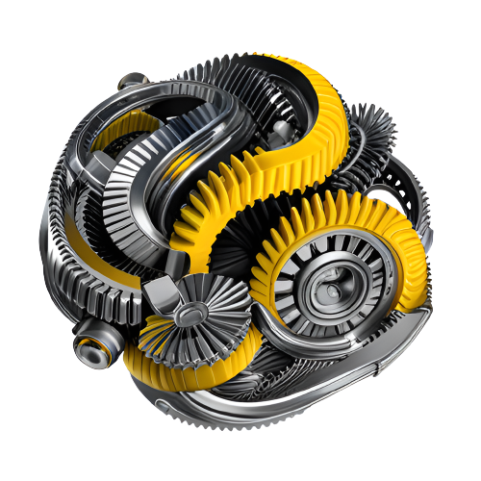
Data Wrangling
We have merged two datasets i.e., EmoBank and data generated using ChatGPT4.
Then data is pre-processed to remove all the clutter that may exist, like website links, unwanted punctuations etc..
We tried to preserve any special characters that can contribute to emotion prediction.

Slide 9

AURA-TEXT FRAMEWORK
Our devised system incorporates three different BERT architectures, each trained independently on individual variables.
The unique training approach acknowledges the independence of the three variables(V,A,D).
Once these models have been effectively trained, their predicted outputs are fed into an emotion-converter, which derives the emotional tone of the predicted sentence.

Slide 10

AURA-TEXT FRAMEWORK
The Emotion convertor works on the principle of Mahalanobis distance¹, which is a measure between a sample point and a distribution.
The emotion convertor will give top five emotions which are closest to the predicted VAD value in a 3D space with their intensities in percentage.
References:
1.https://www.researchgate.net/publication/225427767_Mahalanobis_Distance

Slide 11
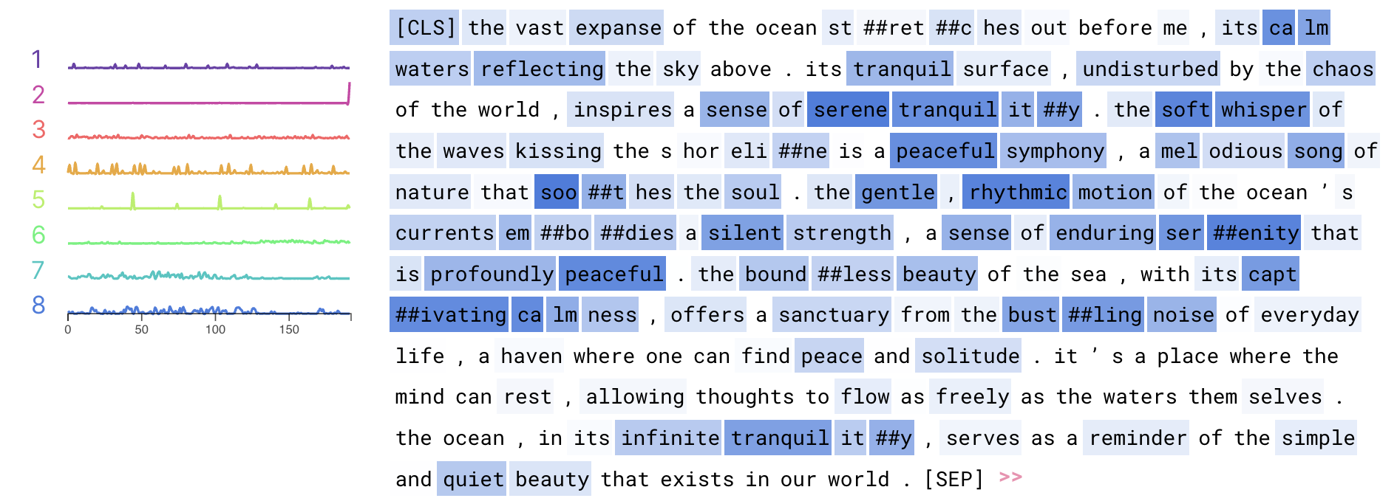
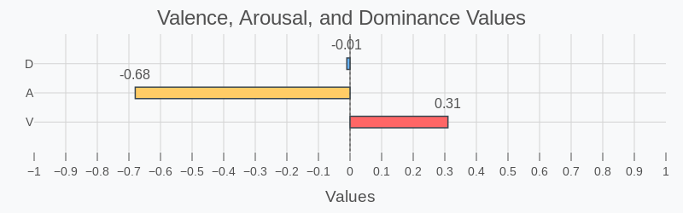
Framework Result
Test Sentence: The vast expanse of the ocean stretches out before me, its calm waters reflecting the sky above. Its tranquil surface, undisturbed by the chaos of the world, inspires a sense of serene tranquility. The soft whisper of the waves kissing the shoreline is a peaceful symphony, a melodious song of nature that soothes the soul. The gentle, rhythmic motion of the ocean's currents embodies a silent strength, a sense of enduring serenity that is profoundly peaceful. The boundless beauty of the sea, with its captivating calmness, offers a sanctuary from the bustling noise of everyday life, a haven where one can find peace and solitude. It's a place where the mind can rest, allowing thoughts to flow as freely as the waters themselves. The ocean, in its infinite tranquility, serves as a reminder of the simple and quiet beauty that exists in our world.
Activations of a All Layers
Model Predictions
We can observe that the model concentrates on such words that are related to emotions, though this is human intuition as the model never sees the actual emotions. words like "tranquil", "peaceful", "solitude", "symphony"

Slide 12
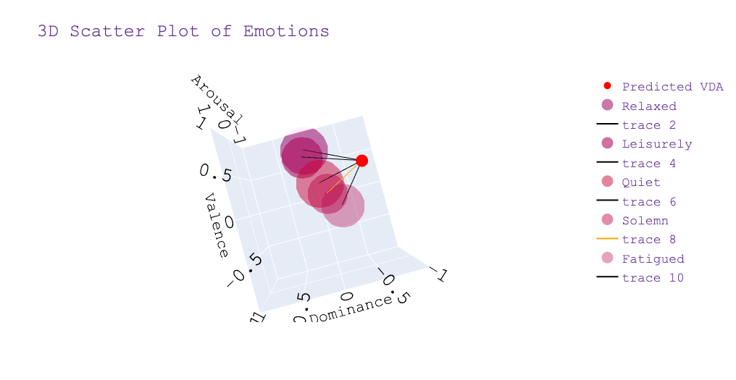
Framework Result
The point closely resembles the following emotions with the following intensities:
Quiet : 83.60 %
Relaxed : 83.39 %
Leisurely : 83.21 %
Fatigued : 82.35 %
Solemn : 80.73%
The Orange color trace represents the line connecting the VAD values to the nearest emotion

Slide 13

Conclusion
A framework was successfully devised to predict the emotion behind a sentence using VAD values .
The predicted values were plotted in a 3D-space for better understanding complex emotions.
Furthermore, we visualised how model is understanding the sentences while predicting without knowing the actual emotion.

Slide 14

Future Scope
We will fine-tune more on our models with different training strategies
We will explore architecture which includes encoder-decoder like T5 family.
We will explore our framework’s performance on IEMOCAP and Go_emotions dataset for evaluation

Slide 15
Thank you

